Slide 1

Plant Growth
Data
Classification
Presenters:
Shaili Chauhan
Conference: International Conference on Current Environmental Technologies for Sustainable Development
Date: 9/12/24 – 10/12/24

Slide 2

Background and Motivation
Challenges in Modern Agriculture:
Unpredictable crop growth patterns
Need for precise agricultural management
Limited understanding of growth milestone factors
Project Objectives:
Develop a predictive model for plant growth milestones
Enhance agricultural decision-making processes

Slide 3
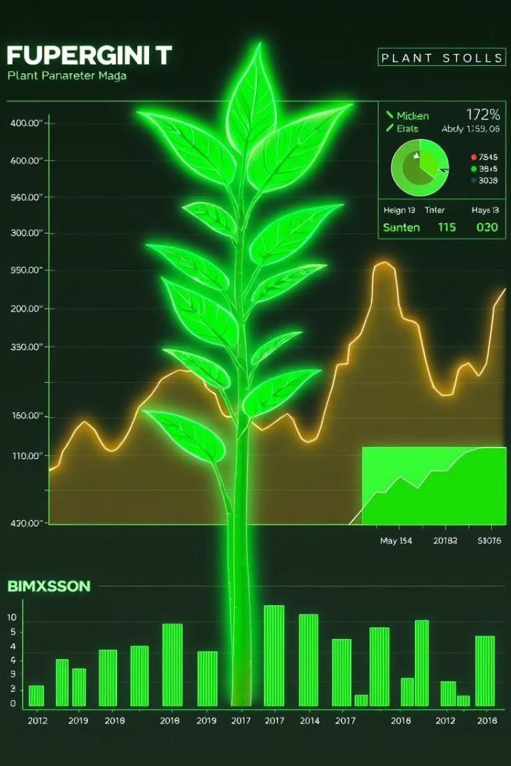
Dataset Overview
Soil Type
Sunlight Hours
Water Frequency
Fertilizer Type
Temperature
Humidity

Slide 4
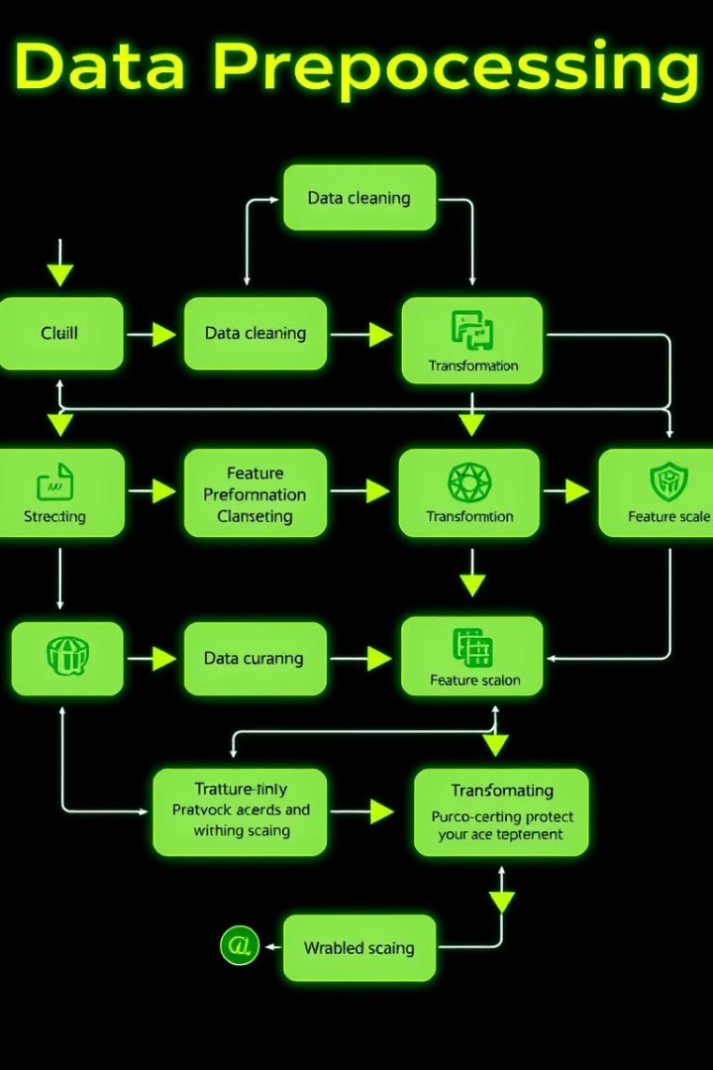


Data Preprocessing
Data Cleaning
Feature Engineering
Addressing missing values and removing duplicates
Converting categorical variables and standardizing numerical data

Slide 5


Technical Implementation
Machine Learning Stack:
Python
Pandas
Matplotlib/Seaborn
Key Technical Approaches:
Advanced preprocessing techniques
Comprehensive model evaluation
Hyperparameter optimization

Slide 6
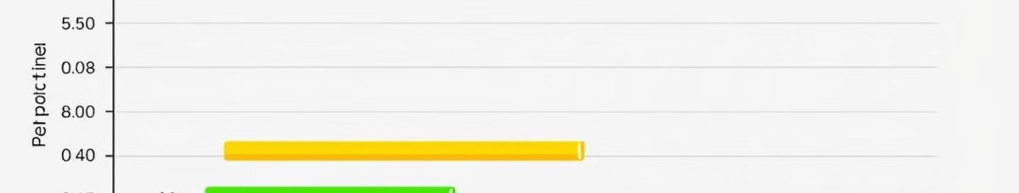
Machine Learning Approach
Random Forest
SVM
Ensemble learning approach for improved accuracy
Powerful method for complex classification problems
Decision Trees
KNN
Interpretable model for understanding decision-making processes
Simple yet effective algorithm for classification

Slide 7



Key Findings and Insights
Random Forest
1
Highest accuracy with 94.10%
Sunlight Hours
2
Strongest influence on plant growth
Soil Type
3
Significant impact on plant development

Slide 8
Challenges and Future Work :
Current Research Limitations:
1
Dataset scope
Future Research Directions:
Expanding dataset diversity
2
Incorporating more complex environmental factors
Developing real-time prediction models
Integration with IoT and sensor technologies

Slide 9
Conclusion and Acknowledgments
Research Summary:
Successful development of plant growth milestone classification model
Proven effectiveness of machine learning in agricultural prediction
Acknowledgments:
Graphic Era Deemed to be University, Dehradun ,Uttarakhand,India
Advisors : Mrs. Garima Sharma
Department of Computer Science
Contact Information:
Shaili Chauhan: shailichauhan06052004@gmail.com
Mrs. Garima Sharma: garimaverma@geu.ac.in

Slide 10
